Slide 1
ADVANCE Database Systems

Slide 2
Week-1: Topics Covered
Relational Database Re-cap
NoSQL Database
Key/Value
Column-oriented
Object Database
Graph Database
Document stores
Databases are used almost everywhere in our lives.
ISON WITH LAST YEAR

Slide 3
Why are Databases important?
Most IT systems and applications use a backend database to store and manage their data and support the functionality of those applications. All of the following use databases:
Social media apps (Facebook, Instagram Twitter, LinkedIn, WhatsApp)
Online banking
Web applications such as online booking and shopping sites
Line of business applications (HR, Finance, Student Records, Marketing, Order Processing)
Online games
Data warehouses to support reporting and business intelligence.
Big Data applications
Databases are used almost everywhere in our lives.
ISON WITH LAST YEAR

Slide 4
Types of databases
There are many types of databases, each one being more appropriate to different types of applications but simply speaking there are two main types:
Relational databases (better for structured data)
Non-relational / NoSQL databases (better for unstructured or semi-structured data)
Databases can be stored on local servers or in the cloud.
They can be centralised in one location or distributed across different locations.
We will concentrate on Non-relational databases in this unit.
ISON WITH LAST YEAR

Slide 5
What is a relational database?
ISON WITH LAST YEAR
A relational database is one in which the data consists of a ‘collection of tables linked by common data values’
Prominent characteristics are:
data stored in tables
relationships between tables
Oracle
SQL Server
MySQL
PostgreSQL
DB2
Informix
Amazon RDS
MariaDB
SQLite

Slide 6
An example table
Employees
ISON WITH LAST YEAR
ID value uniquely
identifying each row
An attribute
(or column)
A record
(or row)
Notes:
A table (or relation) is a set of data about instances of a particular entity (e.g. employees)
An attribute (or column) represents a characteristic of an item (e.g. the employee’s job title)
A record (or row) represents the set of values (all the columns) for a particular instance (e.g. one employee)
To maintain integrity, each individual record should be uniquely identified

Slide 7
An Example relationship
Deptno (Foreign key)
Deptno (Primary Key)
EMP table
matches
DEPT table
Note: King, Clark and Miller are all in department 10
From the dept table
we can see that this is Accounting and is located in Oxford.
Therefore King Clark and Miller all work for Accounting and are located in Oxford.
One to many (1:m)
One department (Accounting)
has many employees (King, Clark, Miller)
ALSO
One employee (King) works for one department (Accounting)
Notes:
In order to maintain the integrity of a relational database, each table should have a primary key column that uniquely identifies each row e.g. a Dept_no which is unique to each employee. This is called entity integrity.
In any other tables where that primary key column appears, a foreign key is created to ensure that any value entered exists in the primary key table e.g. a dept_no in an Employee table should be a valid dept_no that exists in the Dept table. This is called referential integrity.
There are other ways that the integrity of the database can be maintained which we will explore later in the unit.

Slide 8
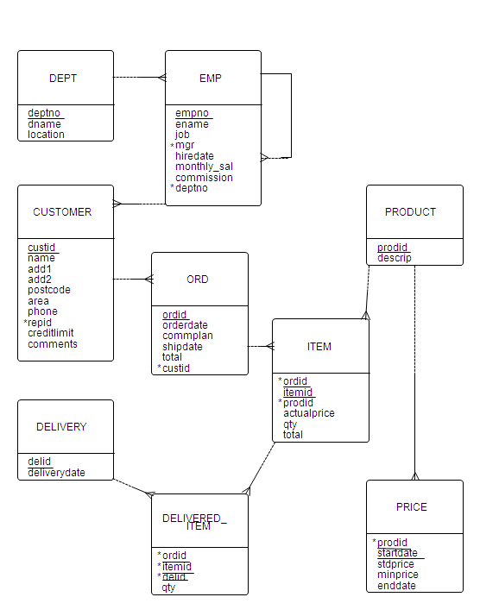
Entity relationship diagram (ERD)
Each box represents a table (entity)
The table name is shown at the top.
In the bottom half of the box, the attribute (column) names of the table are listed.
The underlined attribute(s) is/are the Primary Key to uniquely identify each row in a table
Attributes marked with an asterisk (*) are Foreign Keys which are used to link to primary key values in another table
The MySports Data Model

Slide 9
Entity relationship diagram (ERD)
The lines between the boxes represent the relationships between the tables.
The ‘crows foot’ indicates the many end of the relationship e.g one dept has many emp records
The ‘loop’ on the emp table means that the table has a relationship with itself. Here many employees are managed by one manager (who is also an employee).
The MySports Data Model

Slide 10
Many to many relationships
The real world is full of many to many (m:m) relationships, for example:
Library system: a book is borrowed by many members and a member borrows many books
Ordering system: one order is for many products and a product is included in many orders
Many to many (m:m) relationships cannot be directly implemented in a relational database.
To implement an m:m relationship we must use a ‘link entity’ between the two tables that need a m:m relationship. For example, an item table is created as the ‘link entity’ between product and order.
Each order contains many items, each of which is linked to a product
Each product is referenced by many items each of which is linked to one order
Part of MySports ERD
link entity at the many end of two relationships (crows feet = ‘many end’ of relationship)

Slide 11
Many to many relationships
Part of MySports ERD
The link entity creates not only an explicit m:m relationship between order and product but also an implicit m:m relationship between customer and product
Each product is referenced by many items, each of which is linked to one order, one order is linked to one customer = each product is ordered by many customers
Each customer has many orders, each of which includes many items, one item is linked to one product = each customer orders many products
= m:m relationship between customer and product (as well an m:m relationship between order and product).
link entity at the many end of two relationships (crows feet = many end of relationship)

Slide 12
DATABASE objects
A database consists of many objects types. So far we’ve only looked at TABLES but other object types exist including:
INDEXES - a structure associated with a table that helps the database to more quickly find values in a table improving query performance
VIEWS - a stored SQL query from one or more tables used for security and performance.
TRIGGERS - actions that are performed when a specified database event occurs
Notes:
Indexes - Like an index in a book, database indexes helps the RDBMS to locate data in tables more quickly to speed up the performance of queries on those tables. When you create an index on a column, SQLite will create a data structure for that index where each field value has a pointer to the whole row where that value belongs. Then, if you run a query with a search condition on a column that is part of an index, SQLite will look up for the value on the index first, read the location where the value points for the table row and will locate the row from that location and retrieve it.
Views - A view is a stored SQL query from one or more tables. It does not store the results of the query, just its definition. Unlike some other database vendor implementations, a view in SQLite is read-only. When you have a complex and commonly used SQL query, you can create a view for that query and instead of repeating the SQL query each time, you can simply select from the view.
Trigger - A trigger is an action that the database is told to perform when a particular database event occurs. A trigger defined on a table is executed (fired) whenever you perform operations on a table such as an INSERT, UPDATE or DELETE.
Triggers can be used to 1) Implement business rules, 2) Prevent invalid transactions, 3) Maintain data integrity, 4) Provide event logging for changes to the table

Slide 13
NoSQL DATABASE
NoSQL database is used for non-RDBMS databases
Distributed
Non-relational
Horizontally scalable
ACID properties not fully guaranteed
Atomicity
Consistency
Isolation
Durability
Many solutions driven by web application requirements
Notes:
Tutor – explain the three defining characteristics to the class
Horizontal Scaling: refers to partitioning of the data such as each node contains only part of the data. It is easier to scale dynamically by adding more machines into the existing pool.
Please refer IBM Knowledgebases (https://www.ibm.com/support/knowledgecenter/SSGMCP_5.4.0/product-overview/acid.html) for more details on ACID
Atomicity: All changes to data are performed as if they are a single operation.
Consistency: Data is in a consistent state when a transaction starts and when it ends.
Isolation: The intermediate state of a transaction is invisible to other transactions.
Durability: After a transaction successfully completes, changes to data persist and are not undone, even in the event of a system failure.

Slide 14
NoSQL DATABASE…
Types of NoSQL Database
Object databases (db4o, ObjectStore, Objectivity, Versant, ...)
Column stores (BigTable, HBase, ...)
Document stores (CouchDB, MongoDB, ...)
Key-value (tuple) stores (Membase, Redis, ...)
Graph databases (Neo4j, …)
XML databases (Tamino, BaseX, ...)

Slide 15
Column-Oriented DATABASE
Inspired by Google BigTable
Each key is associated with multiple attributes
Solutions for large scale distributed storage systems
very large "tables" with billions of rows and millions of columns
petabytes of data across thousands of servers
Hybrid row/column stored
Notes:
Google BigTable paper: https://static.googleusercontent.com/media/research.google.com/en//archive/bigtable-osdi06.pdf

Slide 16

Column-Oriented DATABASE
BigTable
distributed storage solution for structured data used by Google
HBase
Distributed open-source database
Linear and modular scalability
Layered over HDFS (Hadoop Distributed File System)
Part of the Apache Hadoop project
API Support – Thrift, REST
Input/Output for MapReduce processing
Map step: master node divides problem into subproblems and delegates them to child nodes
Reduce step: master mode integrates solutions of subproblems
Notes:
Google BigTable paper: https://static.googleusercontent.com/media/research.google.com/en//archive/bigtable-osdi06.pdf
Apache Hbase - https://hbase.apache.org/

Slide 17
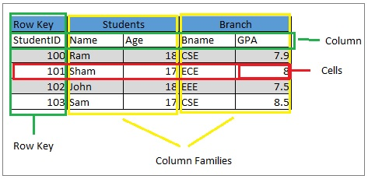
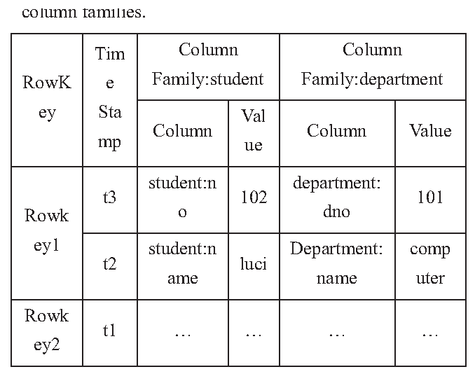
Column-Oriented DATABASE…
Apache HBase Example
Notes:
Image-1 source - https://dwgeek.com/apache-hbase-data-model-explanation.html/
Image-2 source: https://www.semanticscholar.org/paper/Multiple-Nested-Schema-of-HBase-for-Migration-from-Zhao-Li/9f519ba59c0b3d0ecf40064b0ac987ade0a7c488/figure/0

Slide 18
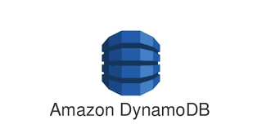
Key/Value Database
Inspired Amazon’s Dynamo DB and distributed hash tables
Data is maintained as a global collection of key/value pairs
Ability to handle massive data loads
Type of Key/Value Databases
In memory (e.g. Memcached)
On Disk (e.g. Redis, SimpleDB)
Eventually Consistent (e.g. Dynamo, Voldemort)
Notes:
Dynamodb - https://aws.amazon.com/dynamodb/
Voldermort - https://www.project-voldemort.com/
Memcached - https://memcached.org/
Redis - https://redis.io/
SimpleDB - https://aws.amazon.com/simpledb/

Slide 19

Key/Value Database…
Voldemort – A distributed key/value database
Created by LinkedIn, now available as open sources
Inspired by Amazon DynamoDB and written in Java
Main Features
Pluggable Storage
Pluggable Serialization
Cluster Rebalancing
Versioning
Consistent Hashing
Virtual nodes
Notes:
Voldermort - https://www.project-voldemort.com/

Slide 20
Object Databases (ODBMS)
ODBMS combines the features of
Object-oriented language
DBMS
ODBMS use the same data model as object-oriented programming languages
ODBMS treat data as objects
Object identity
Attributes and methods
Relationships between objects
Extensible type hierarchy
Inheritance, overloading and overriding as well as customised types
Declarative query language
Notes:
The Object-Oriented Database System Manifesto by Atkinson et al defines 13 mandatory features that an object-oriented database system must have
8 object-oriented system features
5 DBMS features
Object-oriented system features
complex objects
object identity
encapsulation
types and classes
type and class hierarchies
overriding, overloading and late binding
computational completeness
extensibility
DBMS features
persistence
secondary storage management
concurrency

Slide 21
Object Databases (ODBMS)…
ODBMS also implement a versioning mechanism
Operations are performed by using a navigational interface rather than a declarative interface
In addition, an object query language (OQL) can be used to retrieve objects in a declarative way
Faster access than RDBMS for many tasks as no join operations are required
Object databases lack a formal mathematical foundation

Slide 22
Object-Relational Database
Object-relational data model extends the relational data model
Introduces complex data types
Object-oriented features
Extended version of SQL to deal with the richer type system
Complex data types
New collection types including multisets and arrays
Attributes can no longer just contain atomic values (1NF) but also collections
nest and unnest operations for collection type attributes
ER concepts such as composite attributes or multivalued attributes can be directly represented in the object-relational data model

Slide 23
Object VS Object-Relational Database
Object Databases
Complex datatypes
Tight integration with an object-oriented programming
High performance
Object-Relational Databases
Complex datatypes
Powerful query languages
Good protection of data from programming errors

Slide 24
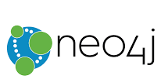


Graph Database
Inspired by Euler graph theory, G= (E,V)
Focused on modeling structure of data
Property graph data model
Examples:
Neo4j
HyperGraphDB
InfiniteGraph
Notes:
Neo4J -https://neo4j.com/
InfiniteGraph - https://objectivity.com/products/infinitegraph/
HyperGraphDB - http://www.hypergraphdb.org/

Slide 25
Graph Database -
Embedded database, written in Java
Data Model = property graph
Node
Relationships
Properties on both
Primary operation is graph traversal
Disk-based: Graph stored in binary format
Capable to handle billions of nodes/relationbship/properties per JVM
Available under AGPLv3 and commercial licensing model
Notes:
Neo4J -https://neo4j.com/

Slide 26
Graph Database - …
Supported languages
Jython, Cpython
Jruby
Scala with RESTful API
Applications
Social Graph - Facebook
Recommendation engines
Financial audit
Notes:
Neo4J -https://neo4j.com/

Slide 27
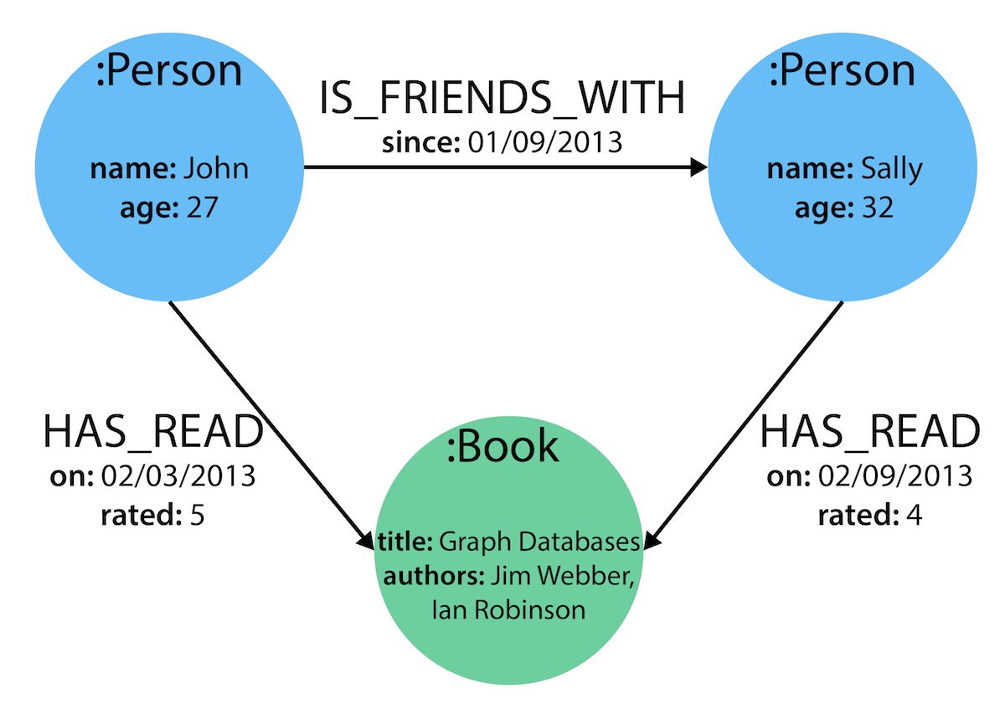
Graph Database – NEO4J Example
Notes:
Image source - https://neo4j.com/developer/guide-data-modeling/

Slide 28


Document Stores
Data is no longer stored in tables
Similar to key/value databases – except value is a document
Each record (document) might have a different format (number and size of fields)
Flexible schema
Documents stored in JSON format
Examples
MongoDB
Apache's CoucheDB
Notes:
MongoDB - https://www.mongodb.com/
CouchDB - http://couchdb.apache.org/

Slide 29
MongoDB
Written in C++,
MongoDB project started in 2007
Commercially supported by 10Gen
Supported languages (database connectivity drivers)
C/C++
Java/Javascript
Perl
Python
Rbuy

Slide 30
MongoDB…
Support AdHoc queries
Support multiple types of indexing
Replication uses a master/slave model
Support horizontal scaling via sharding
Community Support
Scala
Node.js
Haskell
Erlang
Smalltalk

Slide 31
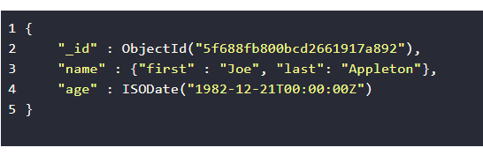
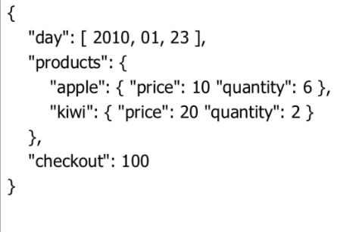
MongoDB- Example

Slide 32
CURD operation in MongoDB
Create Operations
Add/Create a new document to a collection
Read Operations
Retrieve a document from a collection
Update Operations
Modify an existing document in a collection
Delete Operations
Remove a document from a collection
Bulk Write
Perform write operation in bulk

Slide 33
summary
Relational Database Re-cap
Database Objects
NoSQL Databases
Key/Value
Column-oriented
Object Databases
Document stores
Databases are used almost everywhere in our lives.

